Slide 1
Tail To Paw Animal Support
Established 2016
Bobbi Jo Evans, CEO/Founder
Kate Williams, Co-Founder

Slide 2
Our Mission:
To ensure that all animals are provided an equal opportunity to remain in their homes, with loving and supportive owners, by providing basic medical, vaccinations, spay/neuter and food/supplies while assisting in case management of the household.

Slide 3
What We Do:
Basic Medical: up to $300 per household, per year, to cover vaccinations, medical visits,
emergency visits, etc.
Vaccinations: to ensure that animals are allowed into shelters/warming centers and to
remain with owners in their housing
Spay/Neuter: certificates are assisted in obtaining through the State of CT or low-cost
options provided and assisted with in payment via Nutmeg or POA
Food/Supplies: up to $300 per household, per year for food / supplies including RX foods, RX
supplies such as needles, etc.

Slide 4
Case Management:
Case management brings an individual into the home of the pet owner to ensure that the household is receiving all the benefits they are entitled to. These may include, but are not limited to:
Medicaid
Medicare
SNAP
Energy Assistance
Renters Rebate
We strive to provide wrap-around services to pet and pet owner to ensure longevity of their relationship and well-being.

Slide 5
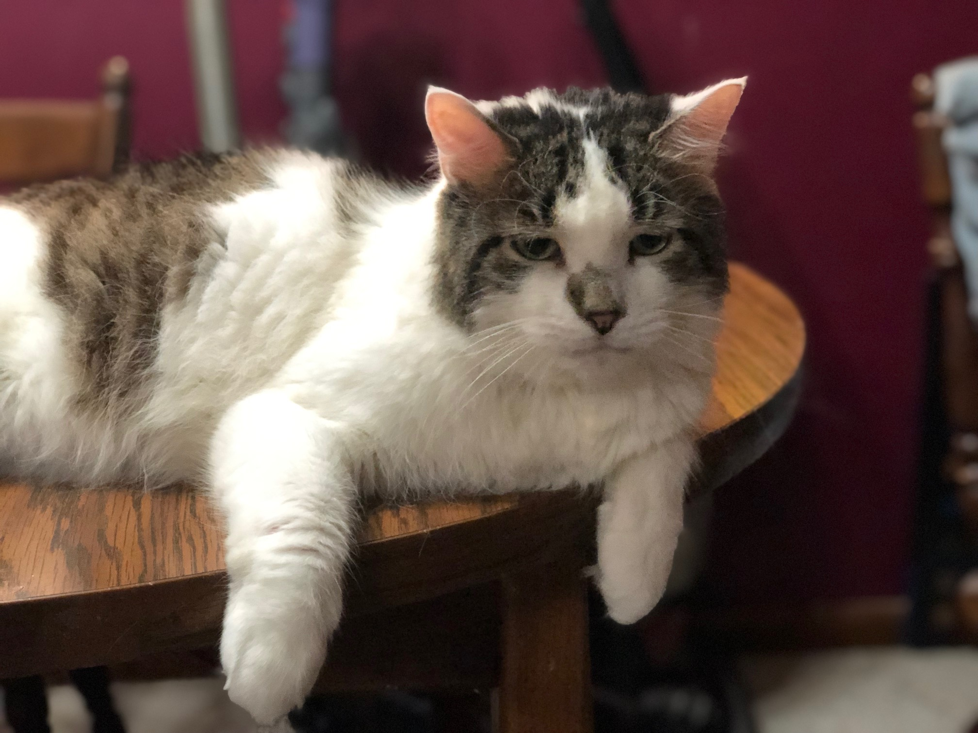
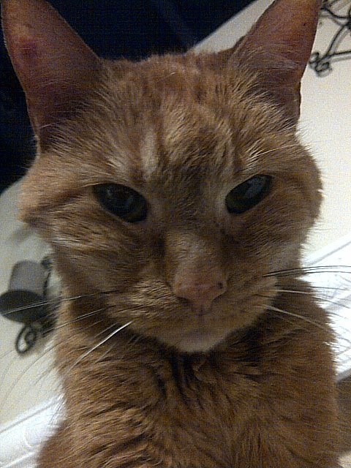
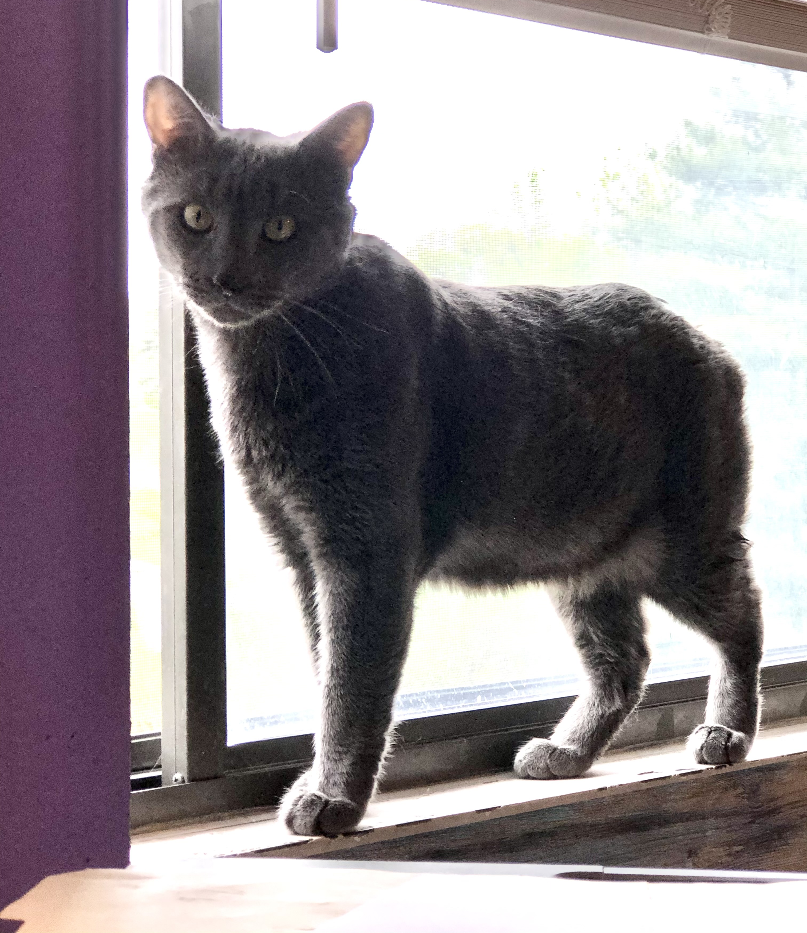
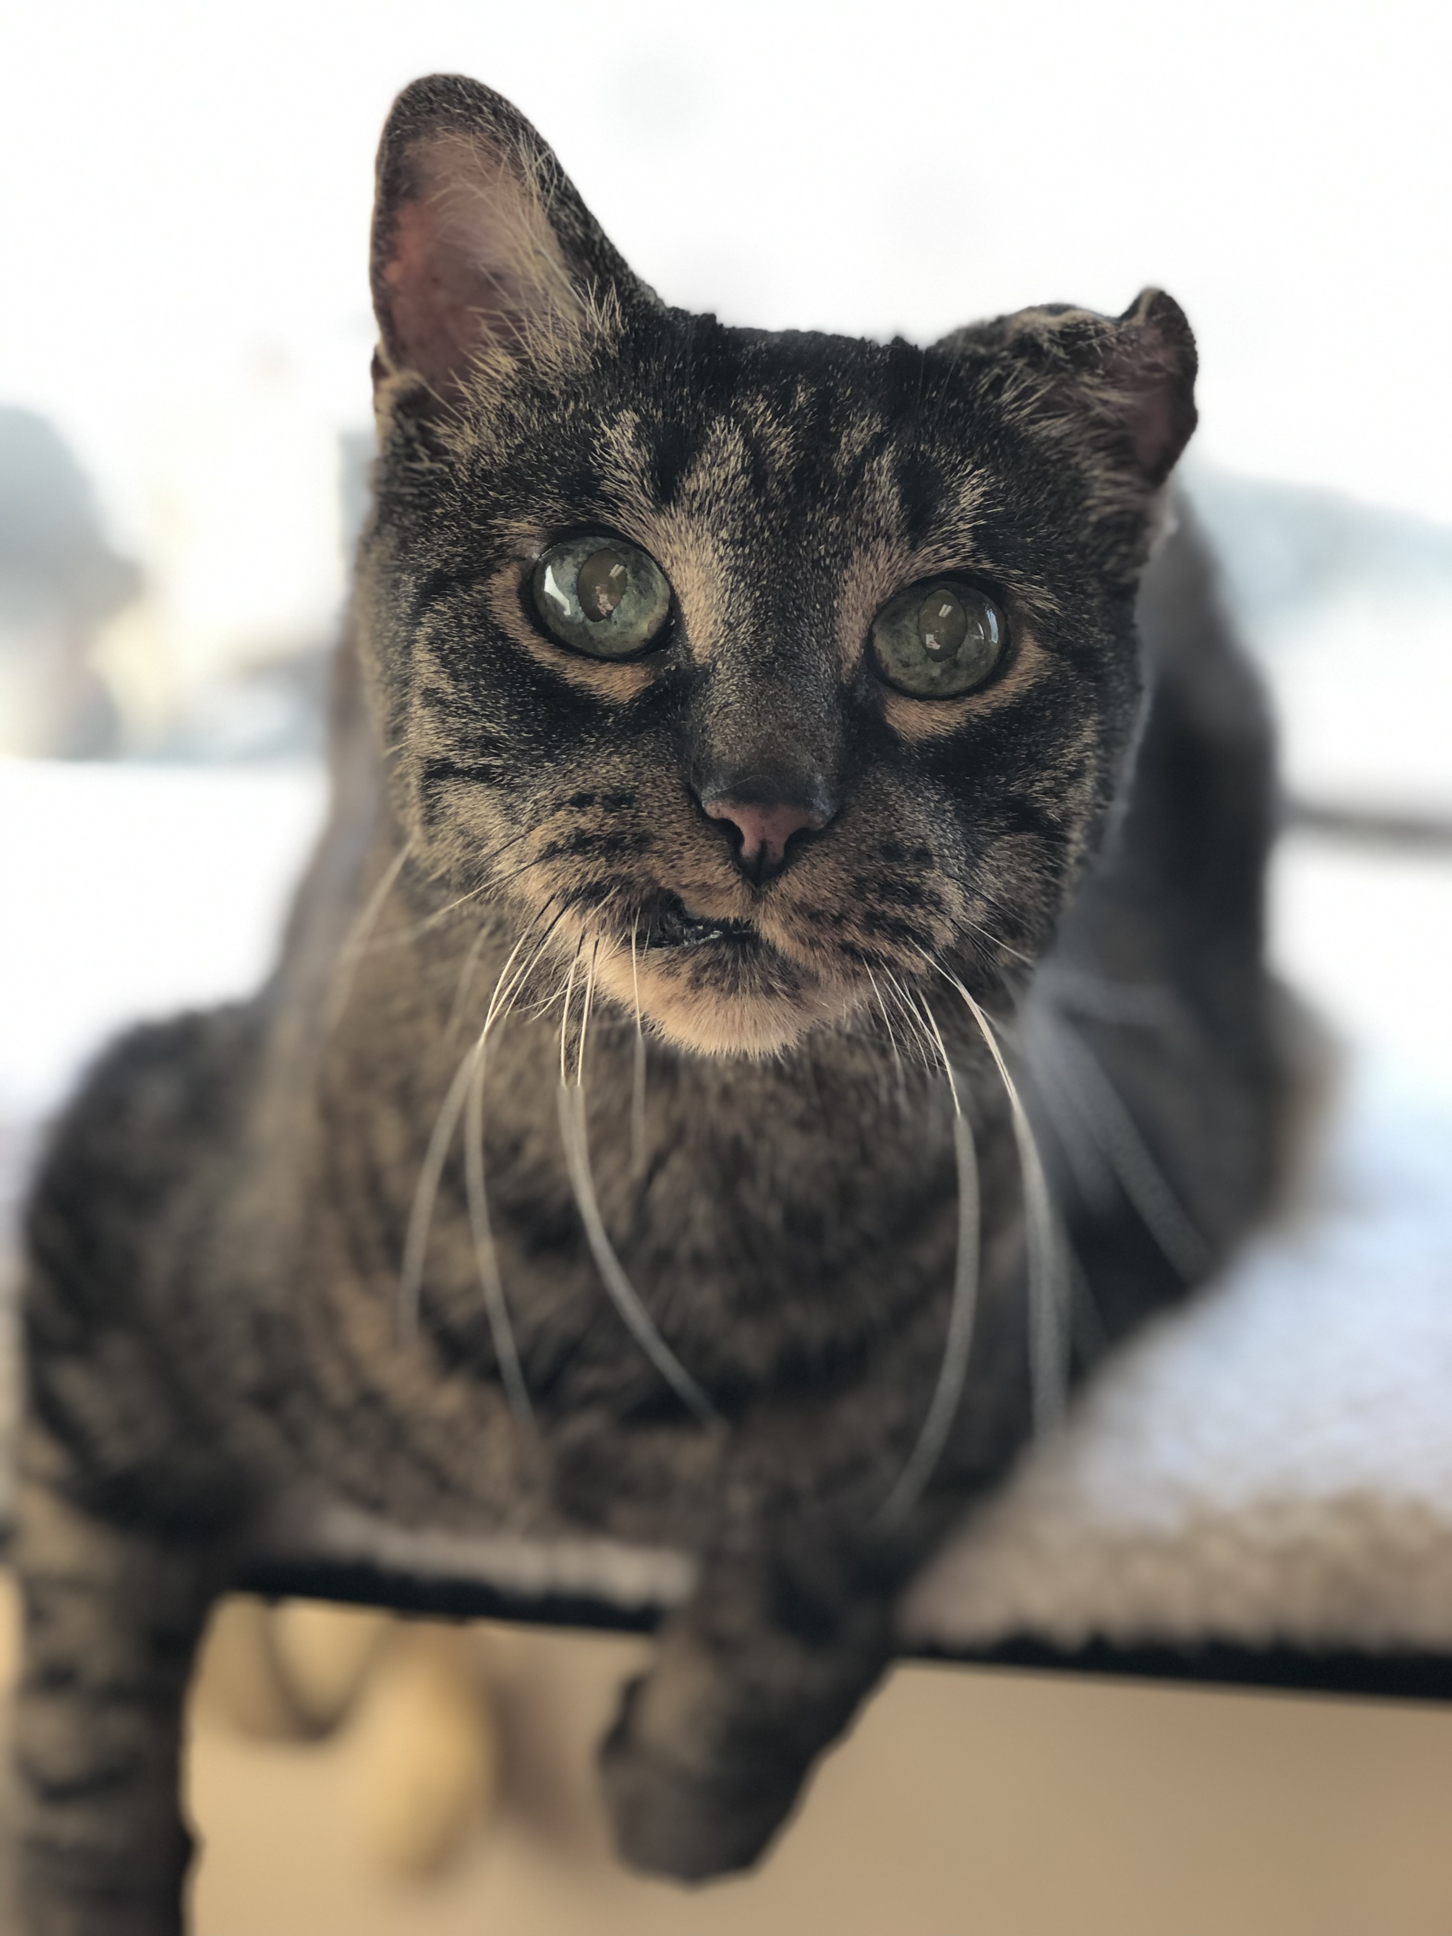
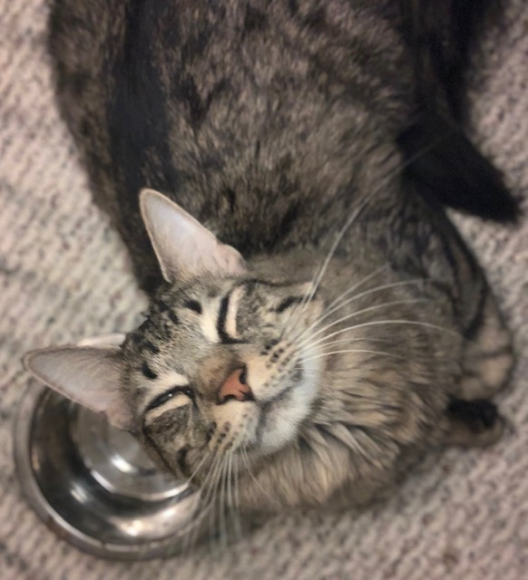
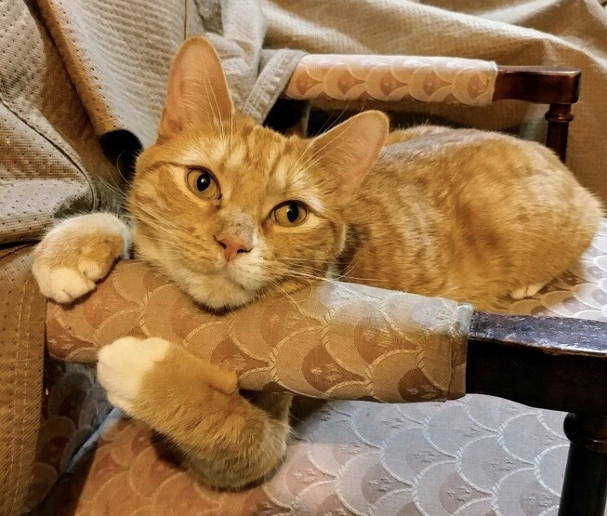
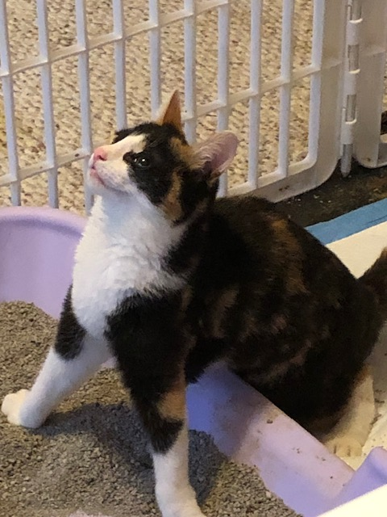
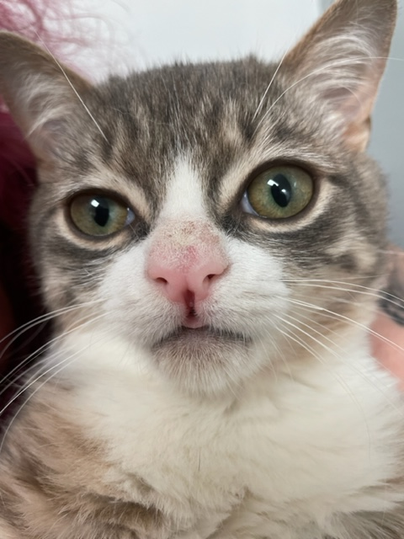
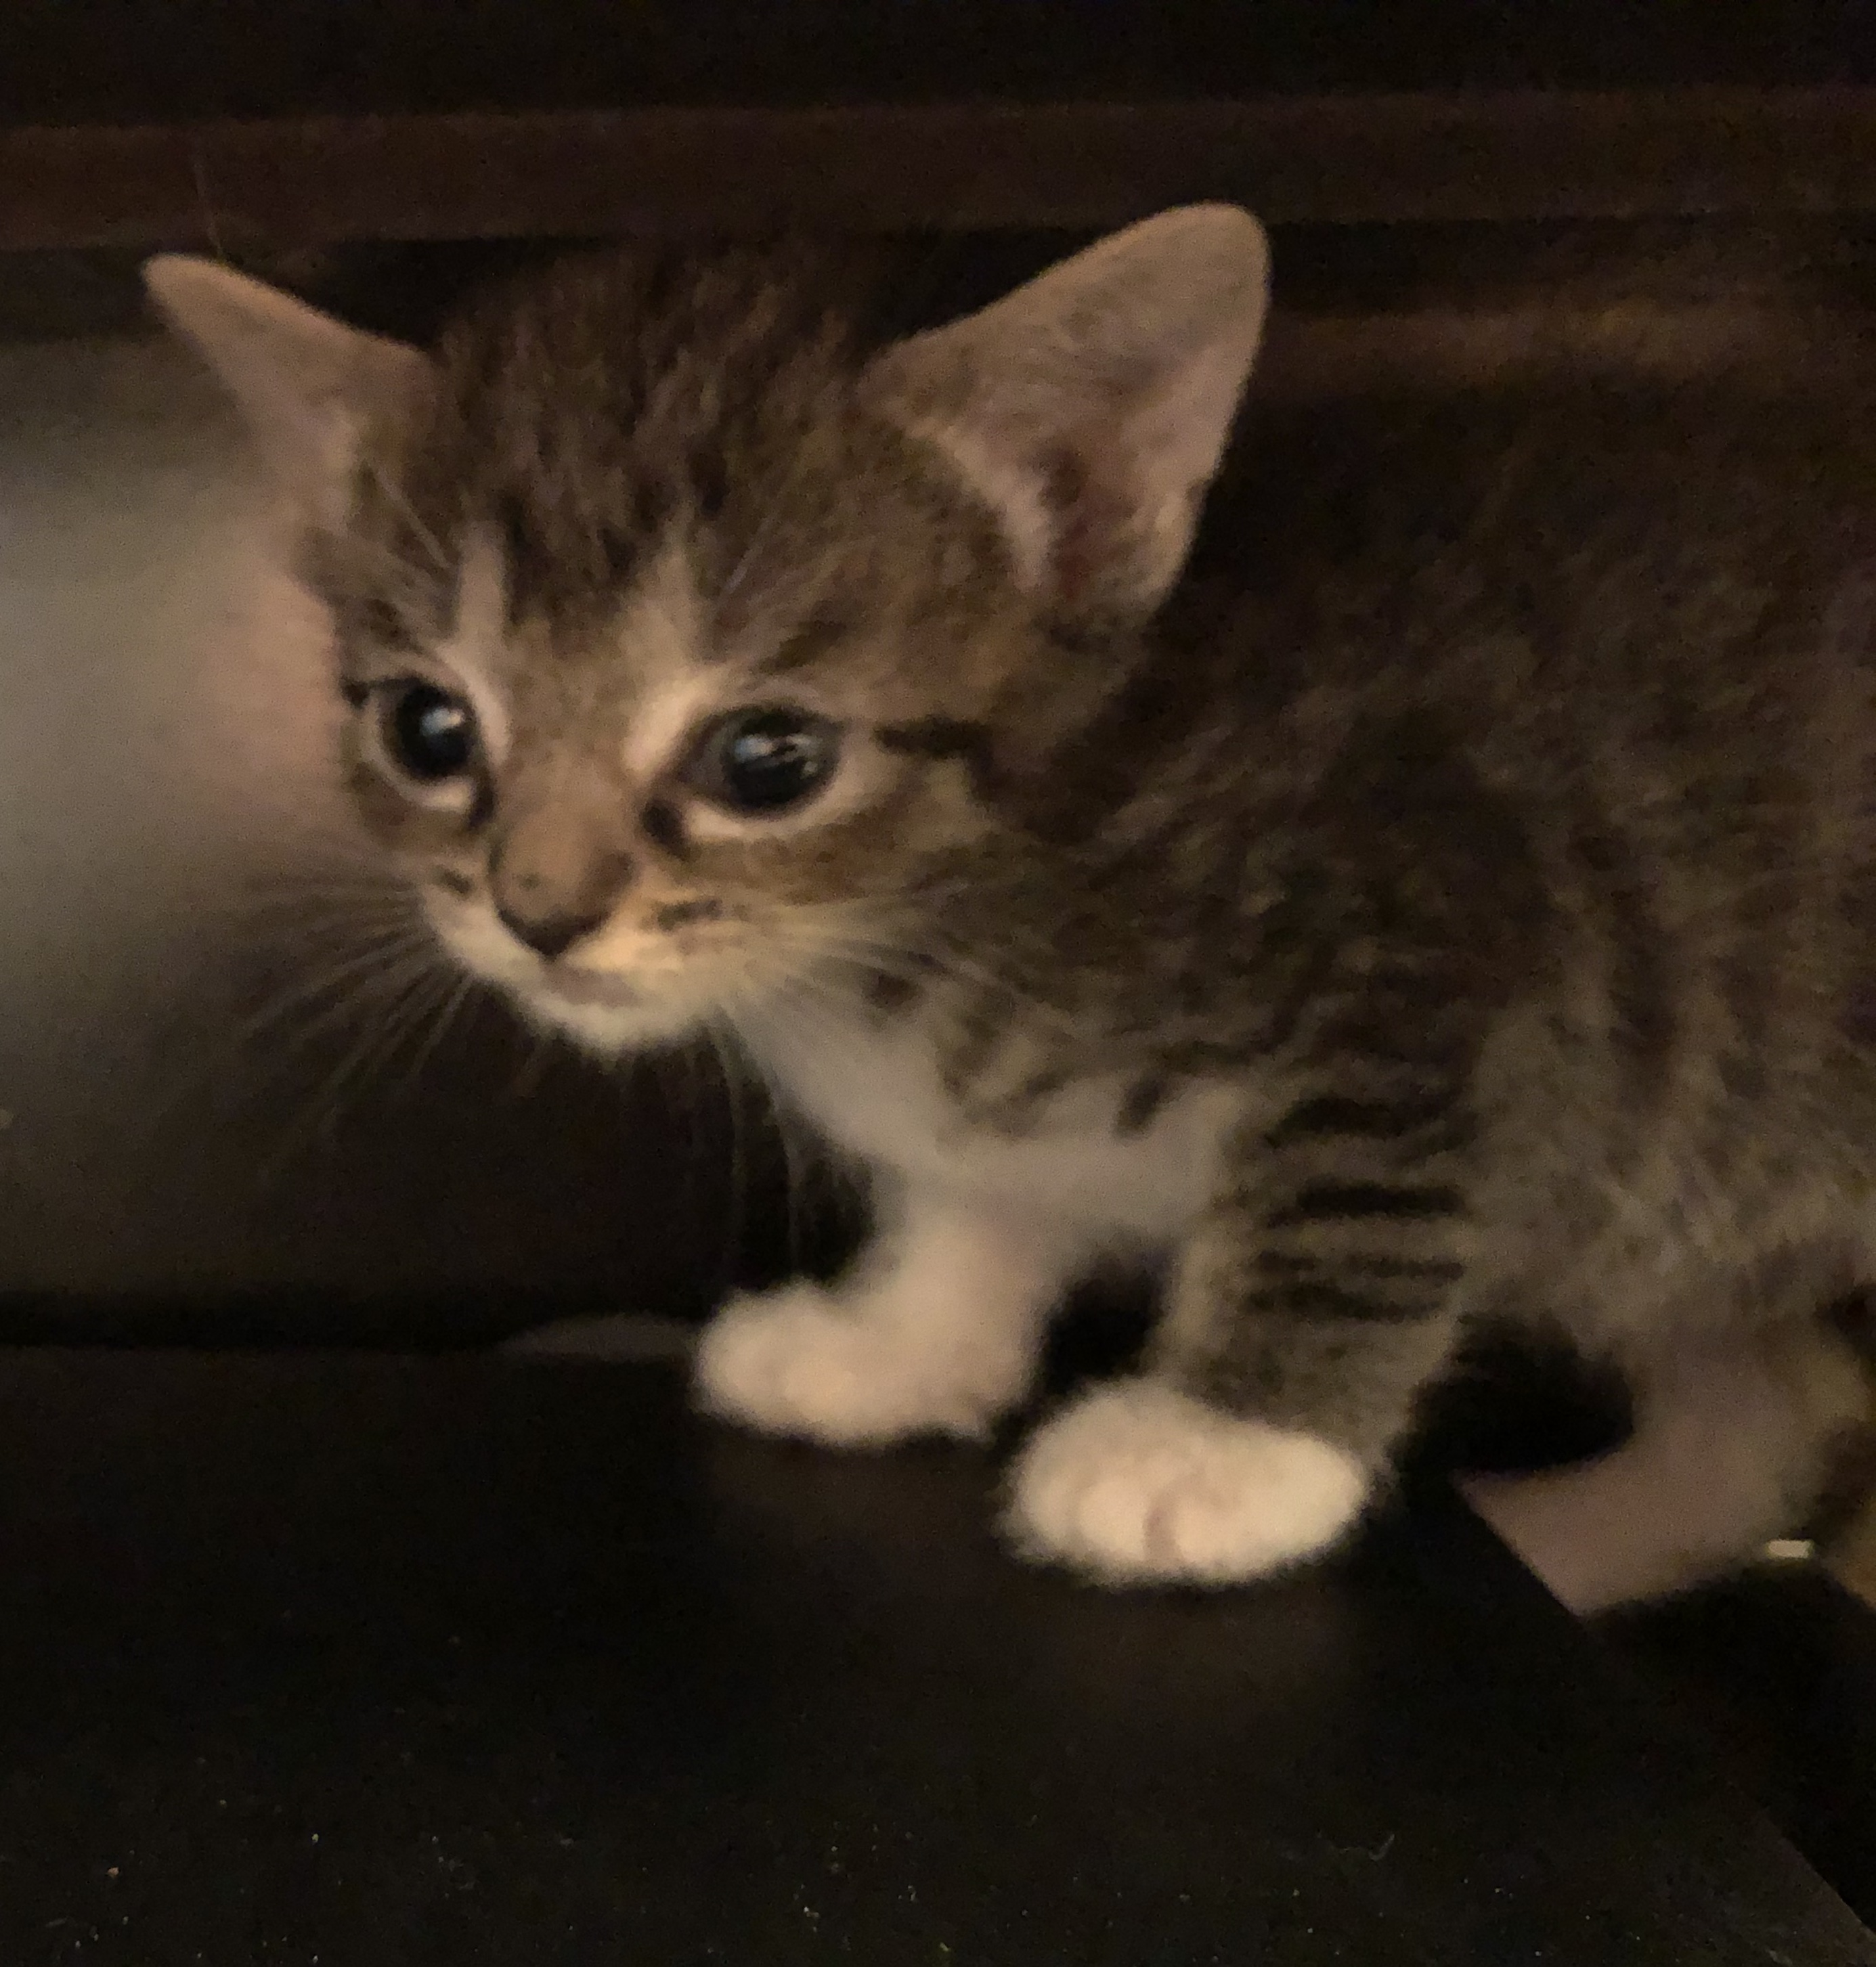
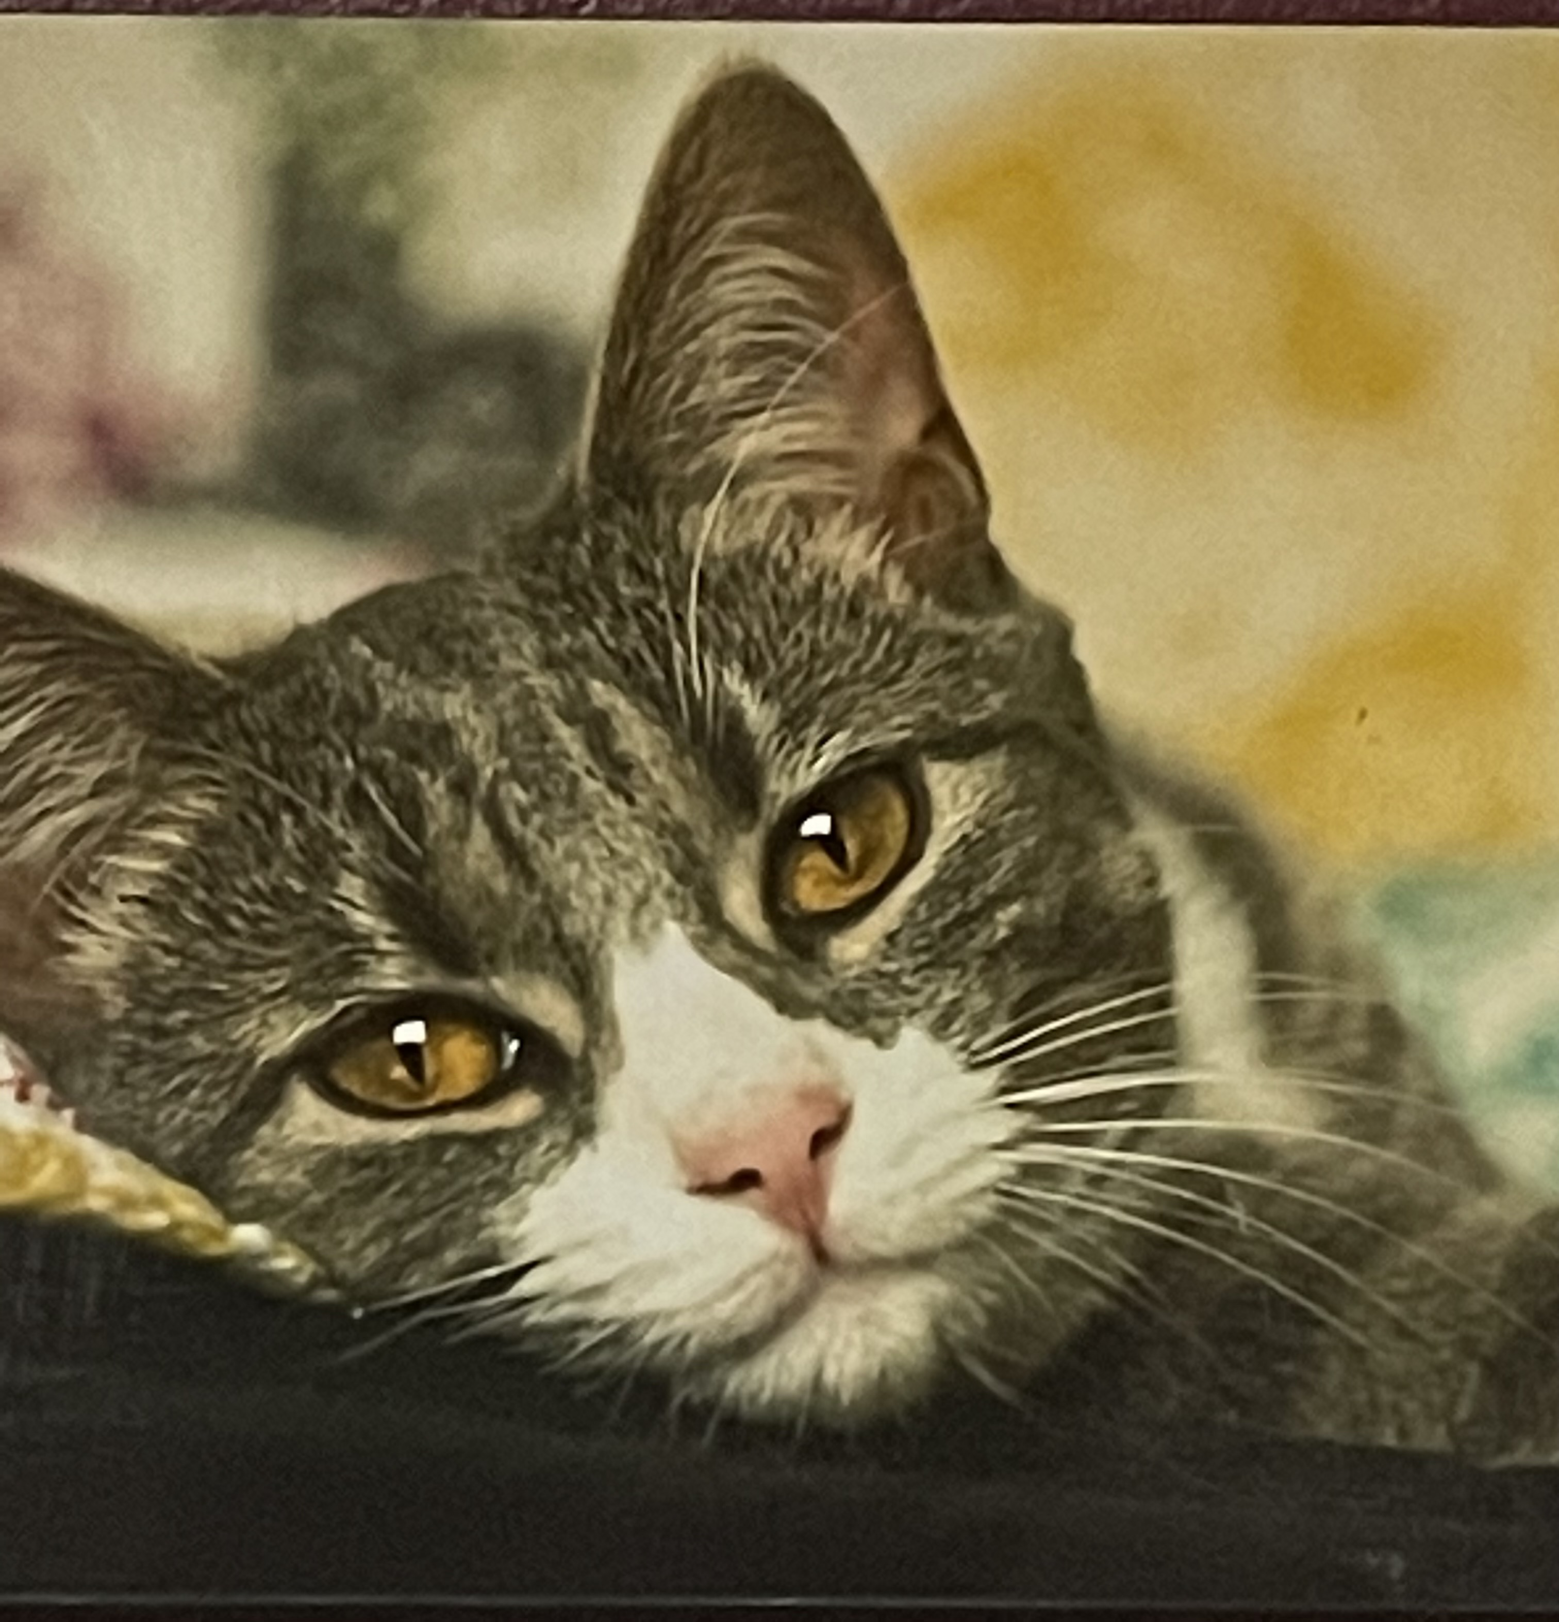
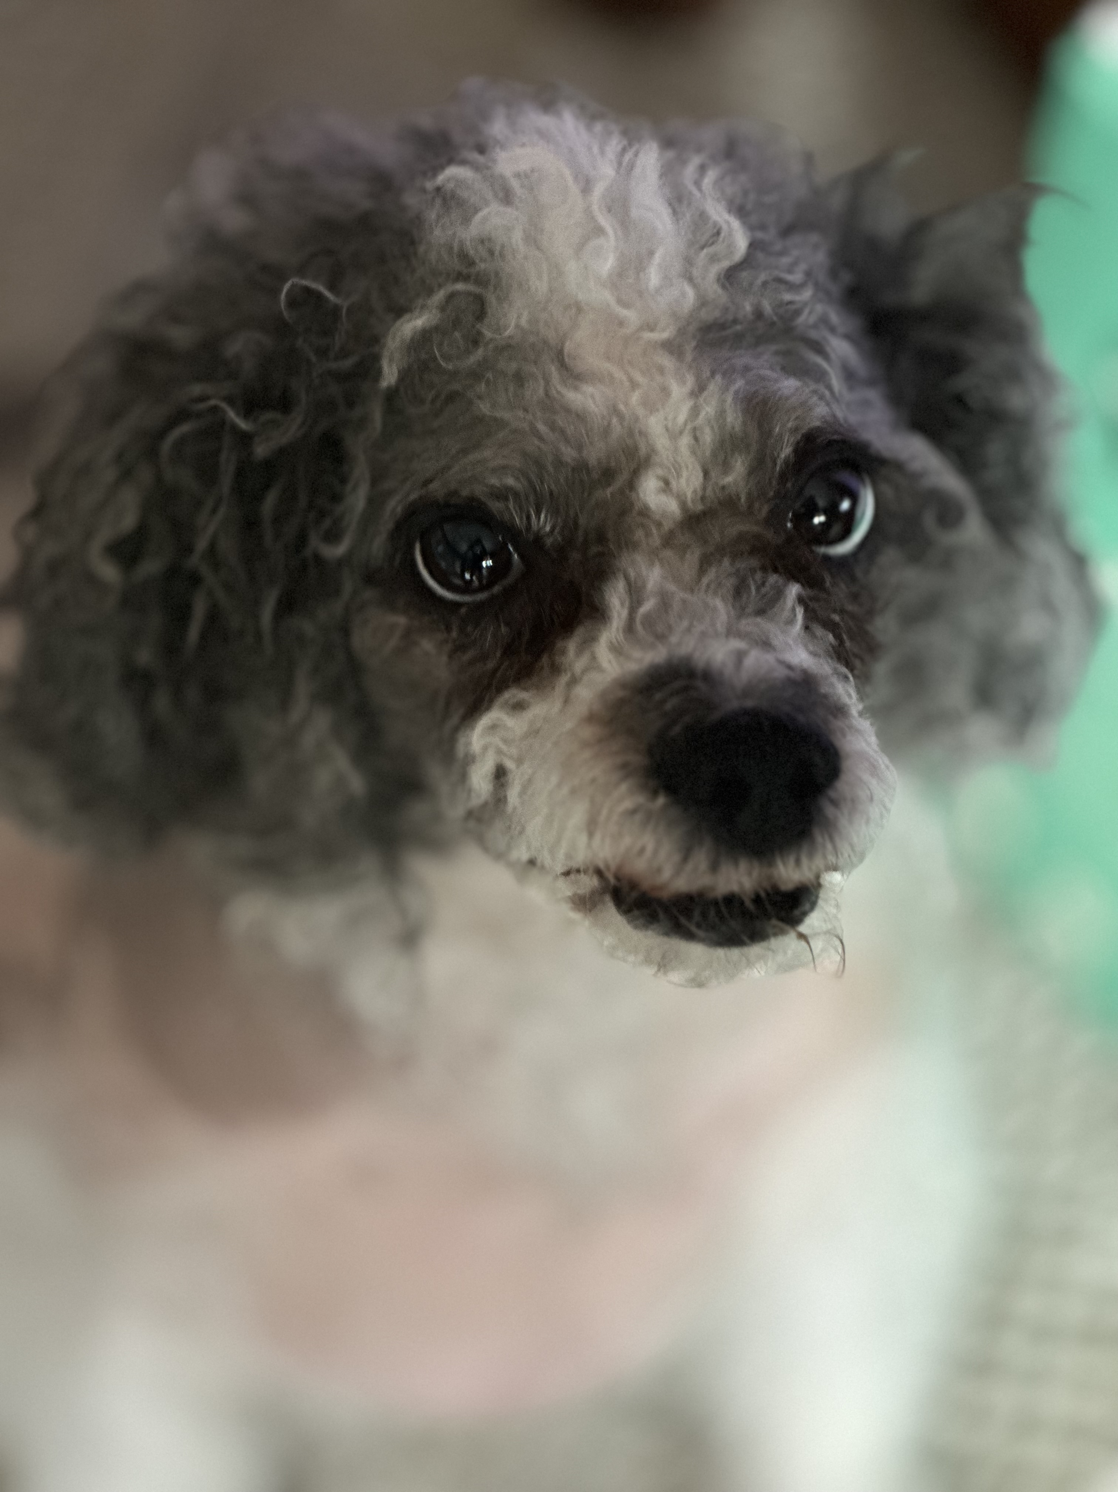
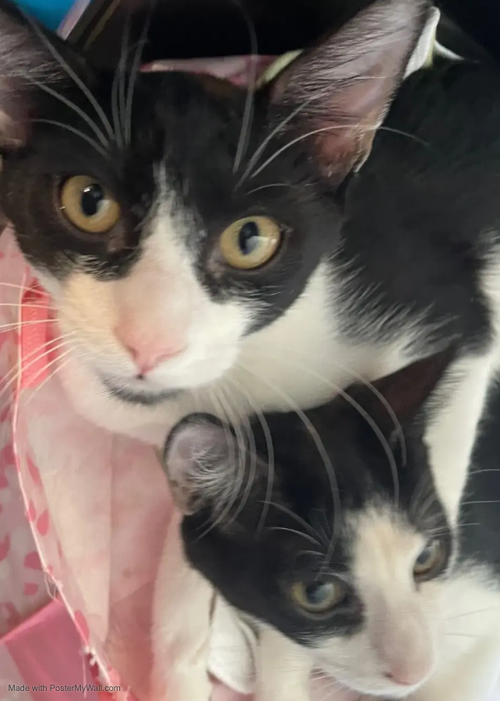
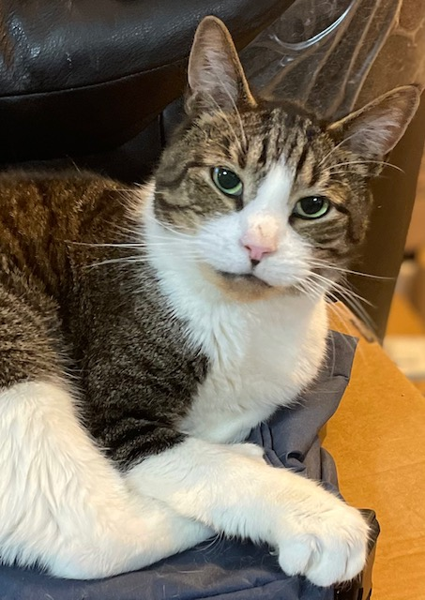
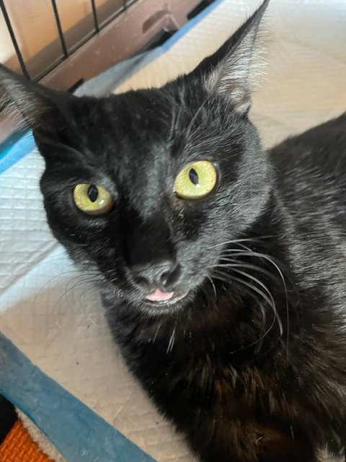
We are NOT a rescue, but we have taken in:
Medically needy “Handi-Cats” and those deemed “Less Desirable”

Slide 6
We have assisted MANY animals to stay with their owners and lead successful lives:
Since 2016:
177 assisted to stay with their owners
$22,429 worth of food and supplies provided to households
64 Spay/Neuter operations provided
51
medical assistance and vaccinations provided

Slide 7
How We Do What We Do

Slide 8
How You Can Help…………
Donations: Tail to Paw can utilize monetary donations for medical costs for clients, as well as food
and supplies
Volunteer: We are in need of additional Board Members who want to be actively involved in enhancing
our mission, expanding our reach and broadening our services
Spread the Word: People can only assist when they know what and who needs the help.
Please share the word about Tail To Paw Animal Support and what we do
and how people can help us to help others.

Slide 9
Thank you!
No Animal Left Behind, No Human Left Alone

